Slide 1

Car accident severity
Capstone Project
Kunal Das

Slide 2
Introduction
Reducing traffic accidents, especially serious accidents, is nevertheless always an important challenge. If we can identify the patterns of how these serious accidents happen and the key factors, we might be able to implement well-informed actions and better allocate financial and human resources.

Slide 3
Motivation
Reducing traffic accidents, especially serious accidents, is nevertheless always an important challenge. If we can identify the patterns of how these serious accidents happen and the key factors, we might be able to implement well-informed actions and better allocate financial and human resources.

Slide 4
Objective
The first objective of this project is to recognize key factors affecting the accident severity. The second one is to develop a model that can accurately predict accident severity. To be specific, for a given accident, without any detailed information about itself, like driver attributes or vehicle type, this model is supposed to be able to predict the likelihood of this accident being a severe one. The accident could be the one that just happened and still lack of detailed information, or a potential one predicted by other models. Therefore, with the sophisticated real-time traffic accident prediction solution developed by the creators of the same dataset used in this project, this model might be able to further predict severe accidents in real-time.

Slide 5
Dataset Overview
US-Accident dataset is a countrywide car accident dataset, which covers 49 states of the United States. It contains 3.5 million cases of traffic accidents that took place from February 2016 to June 2020. In this project, however, only the data of accidents that happened after February 2019 and were reported by US-Accident dataset is a countrywide car accident dataset, which covers 49 states of the United States. It contains 3.5 million cases of traffic accidents that took place from February 2016 to June 2020. In this project, however, only the data of accidents that happened after February 2019 and were reported by MapQuest was finally used in exploration analysis and modelling so that irrelevant factors can be eliminated to the greatest extent.
Link for Kaggle dataset: https://www.kaggle.com/sobhanmoosavi/us-accidentsMapQuest was finally used in exploration analysis and modelling so that irrelevant factors can be eliminated to the greatest extent.
Link for Kaggle dataset: https://www.kaggle.com/sobhanmoosavi/us-accidents

Slide 6
Process
Data cleaning was first performed to detect and handle corrupt or missing records. EDA (Exploratory Data Analysis) and feature engineering were then done over most features. Finally, Logistic regression, Decision Tree Classifier, and Random Forest Classifier were used to develop the predictive model. The final model achieved 98.0% test accuracy on resampled data.
It is worth noting that the severity in this project is "an indication of the effect the accident has on traffic", rather than the injury severity that has already been thoroughly studied by many articles. Another thing is that the final model is dependent on only a small range of data attributes that are easily achievable for all regions in the United States and before the accident really happened.

Slide 7
Key Findings
Country-wide accident severity can be accurately predicted with limited data attributes (location, time, weather, and POI).
Spatial patterns are the most useful features. For small areas like street and zipcode, severe accidents are more likely to happen at places having more accidents while for larger areas like city and airport region, at places having less accident.
Time series features are also very important, especially minute in a day. An accident is more likely to be a serious one when accidents happen less frequently at this time.
If an accident happens on Interstate Highway, there is a 2% chance that it will be a serious one, which is about 2.3 times of average and higher than any other street type.
An accident is much less likely to be severe if it happens near traffic signal while more likely if near junction.
Weather features like pressure, temperature, humidity, and wind speed are also very important.

Slide 8
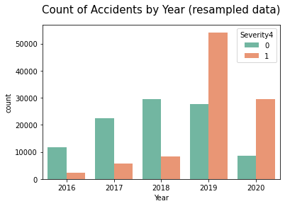
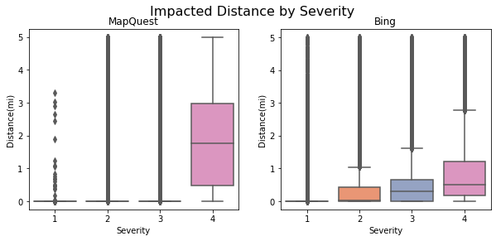
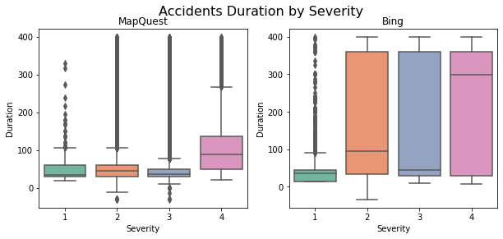
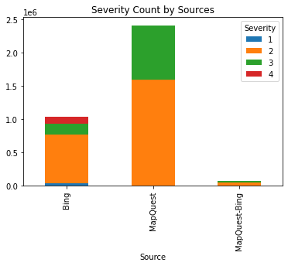
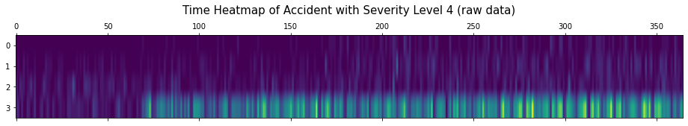
Data Exploration

Slide 9
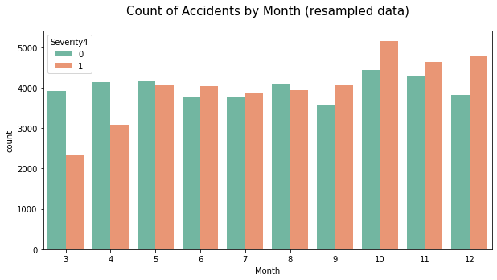
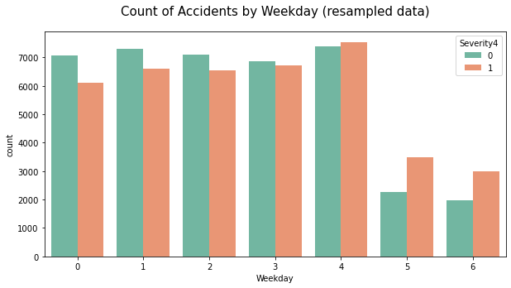
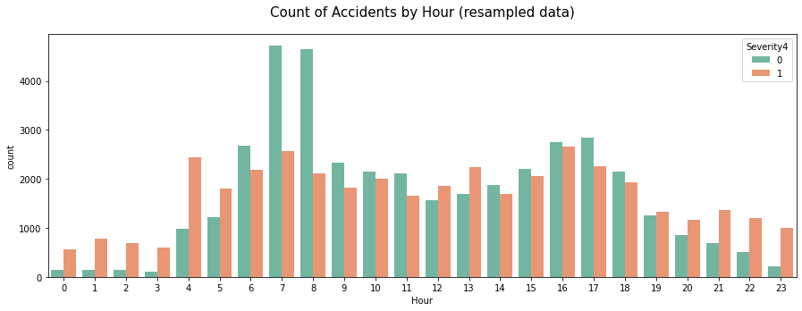
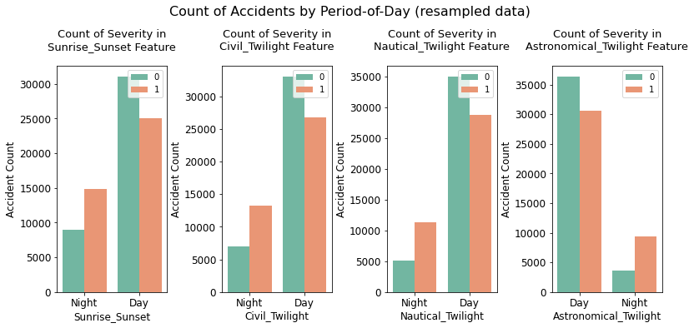
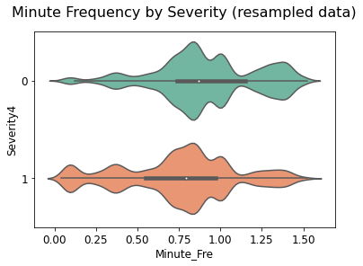
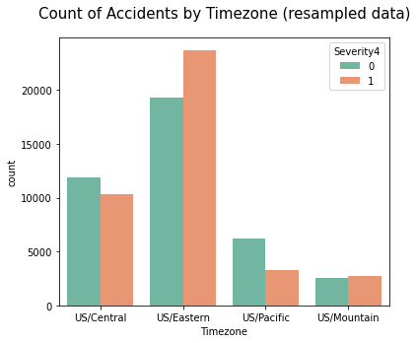
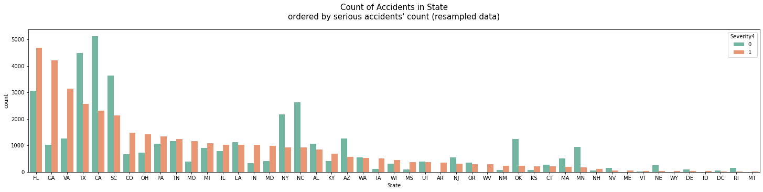
Categorical Data

Slide 10
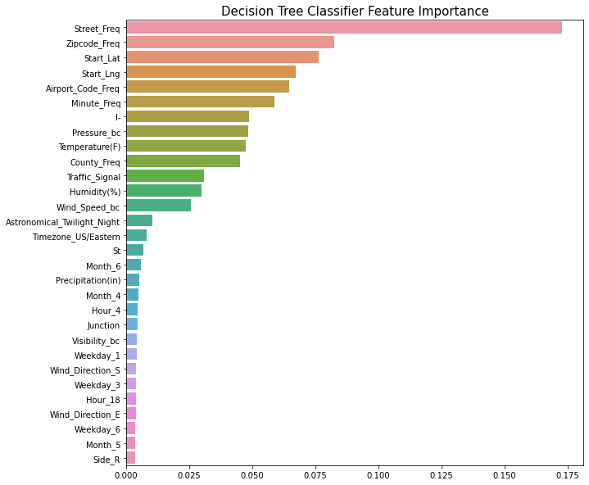
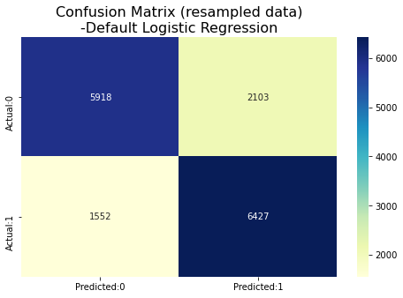
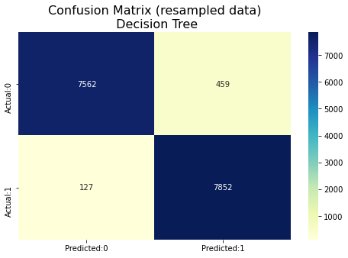
Decision Tree

Slide 11
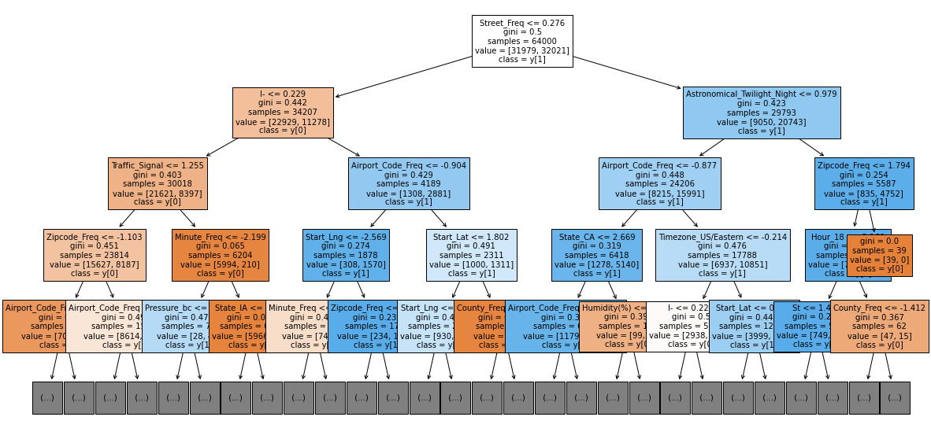
Decision Tree

Slide 12
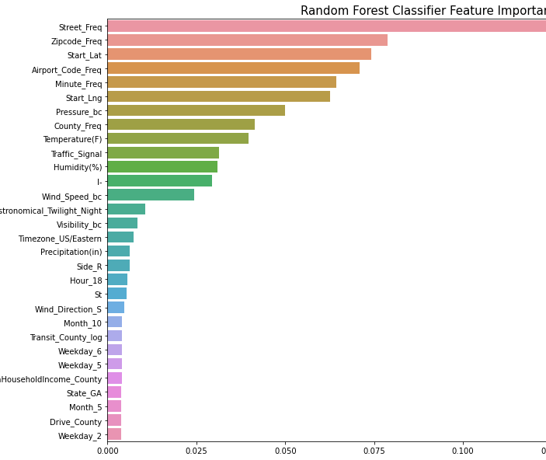
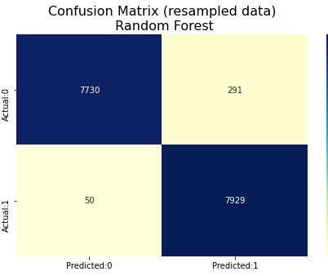
Random Forest

Slide 13
Conclusion & Future Work
Incorporate this model in a real-time accident risk prediction model or develop a new real-time severe accident risk prediction on grid cells.
Detailed relations between some key factors and accident severity can be further studied.
Policy implications of this project can be explored.

Slide 14
Acknowledgement
Moosavi, Sobhan, Mohammad Hossein Samavatian, Srinivasan Parthasarathy, and Rajiv Ramnath. “A Countrywide Traffic Accident Dataset.”, 2019.
Moosavi, Sobhan, Mohammad Hossein Samavatian, Srinivasan Parthasarathy, Radu Teodorescu, and Rajiv Ramnath. "Accident Risk PredictioMoosavi, Sobhan, Mohammad Hossein Samavatian, Srinivasan Parthasarathy, and Rajiv Ramnath. “A Countrywide Traffic Accident Dataset.”, 2019.
Moosavi, Sobhan, Mohammad Hossein Samavatian, Srinivasan Parthasarathy, Radu Teodorescu, and Rajiv Ramnath. "Accident Risk Prediction based on Heterogeneous Sparse Data: New Dataset and Insights." In proceedings of the 27th ACM SIGSPATIAL International Conference on Advances in Geographic Information Systems, ACM, 2019.n based on Heterogeneous Sparse Data: New Dataset and Insights." In proceedings of the 27th ACM SIGSPATIAL International Conference on Advances in Geographic Information Systems, ACM, 2019.

Slide 15
References
USA Accidents Data Analysis
https://www.kaggle.com/sobhanmoosavi/us-accidents/discussion/113055
how Severity the Accidents is ?
Severity Prediction in SFO Bay Area
ML to Predict Accident Severity_PA_Mont
severity and hours wasted
USA Accidents Plotly maps + text classification

Slide 16

Thank You

